Slide 1
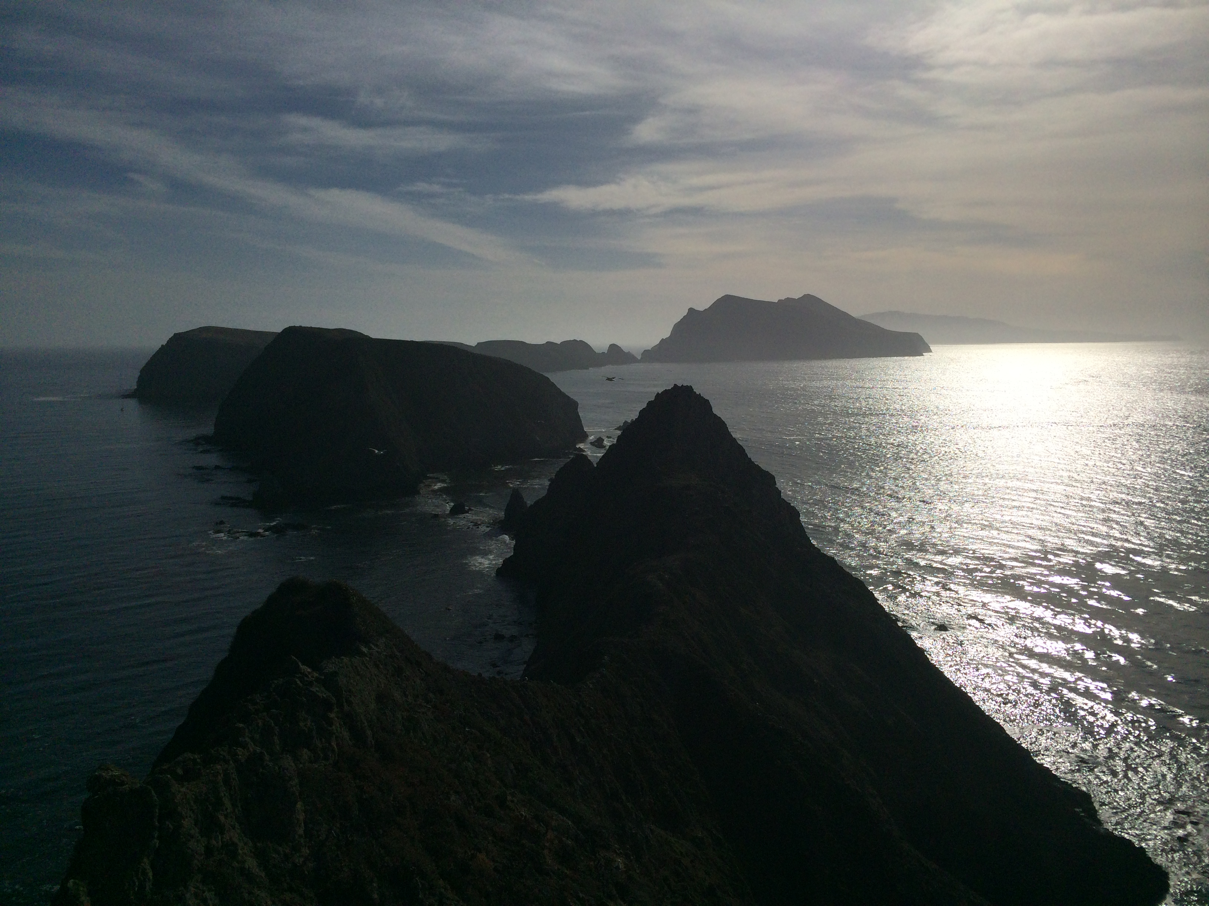
MPA Planning with marlin
Dan Ovando - 2021/08/16

Slide 2
The Challenge
We are moving towards the “tactical” phase of MPA implementation
Less “What are the broad effects of MPAs?”
More “Where should I put this MPA?”
Tactical MPA design can require addressing complex dynamics, particular for pelagic systems
Target and bycatch species with a range of life histories crossing vast distances to utilize a mix of dynamic habitats, captured by multiple fishing fleets with different preferences.
There are many existing MPA design models, each with value, but often limited by
Lack of dynamics
Simplified model structure
Extreme complexity and run time
Notes:
How can we maximize conservation benefits given MPA resources?
How can we maximize fisheries benefits / minimize fisheries losses?

Slide 3
How can marlin help?
marlin is 2-D spatial bio-economic simulation model
Tracks multiple species
Individual species can have their own habitats and movement rates that can very by life stage
Tracks multiple fleets
Each with their own preferred species and selectivity patterns
Accounts for effects of fleets across multiple species
e.g. what happens if you displace effort from one species onto another
Can function in a data-limited environment
Fast enough for large-scale simulation testing & optimization
4 species, 2 fleets, 400 patches, 80 years in 0.35 seconds
Notes:
The goal: remove some of the “it’s too slow” or “it’s too hard to run” reasons for using more realistic models in marine protected area simulation

Slide 4
What Kinds of Questions can marlin Answer?
How should we expect MPAs to perform in pelagic ecosystems?
Can account for large movement rates, dispersed and dynamic habitats, variation across fishing fleets
What are the potential conservation and fishery outcomes of externally generated MPA networks?
e.g. those generated by stakeholders using prioritization analyses
How sensitive are MPA outcomes to key questions posed by stakeholders?
e.g. different theories about habitat, fishing dynamics, life history, or MPA design
How are benefits and costs of MPA network distributed in space?
How do optimized networks compare to outcomes of “rule of thumb” design?
Can optimize internally over different priorities given to conservation relative to fisheries.

Slide 5
Current marlin Projects
Evaluating the Potential of MPAs for Reducing Bycatch in Pelagic Systems
Dan, Darcy, Echelle, Lennon
Assessing the Potential Impacts of Pelagic MPAs on Tuna Fisheries
Dan, Hilborn, Pons

Slide 6
What is needed to run marlin?
marlin is linked to a database of life history traits for a wide array of fin-fish
Users can generate reasonable default values just by entering a common or scientific name
Can overwrite these with local estimates if available
Required user inputs to life history
Either estimate of fishing mortality rate or estimate of current depletion
Adult and larval dispersal rates (roughly max distance moved in a year)
Can take adult and larval habitat layers
Defaults to uniform habitat
Required inputs by fishing fleet
Price and selectivity of each species for each fleet
Relative proportion of total mortality per species per fleet
But can also test sensitivity of outcomes to a range of possible values

Slide 7
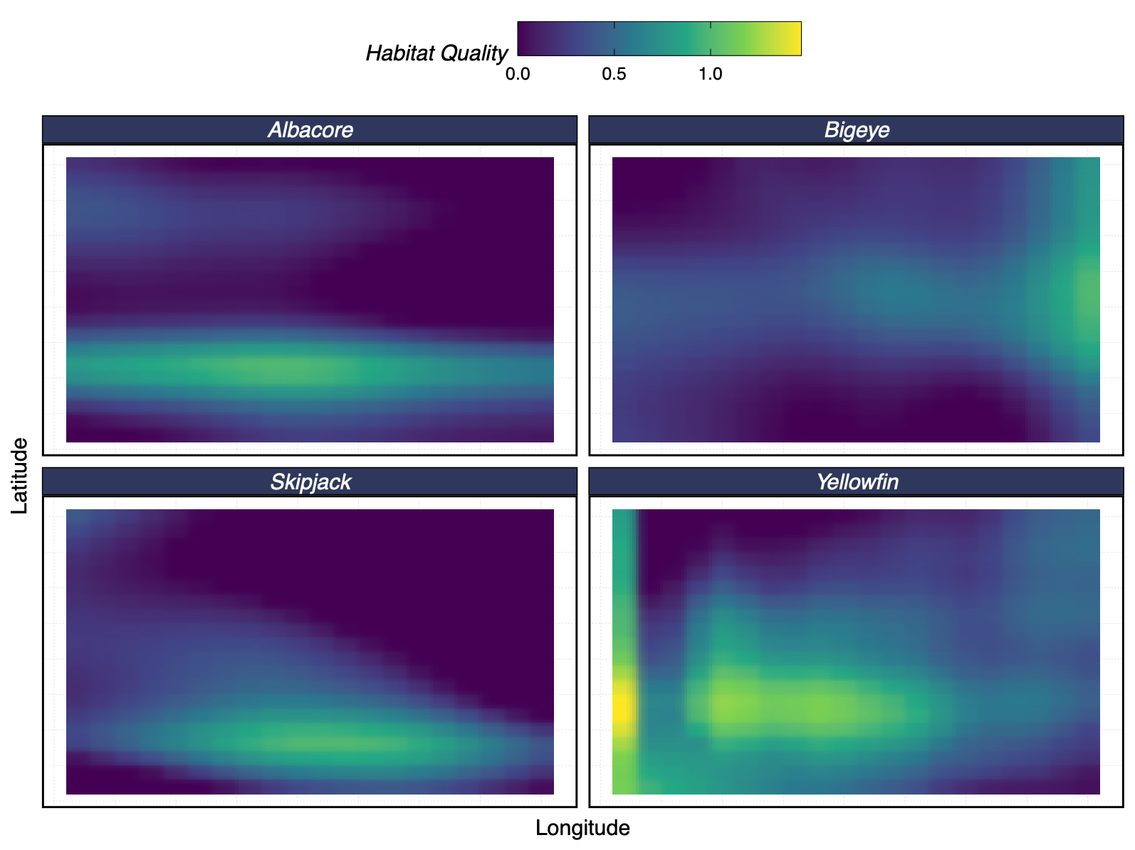
marlin In Action
Suppose tuna distribution in EEZ looks like this
Notes:
EEZ that you’re planning in looks like this

Slide 8
marlin In Action
Conservation Outcomes of MPA Targeting Fishing

Slide 9
marlin In Action
Fishery Outcomes of MPA Targeting Fishing

Slide 10
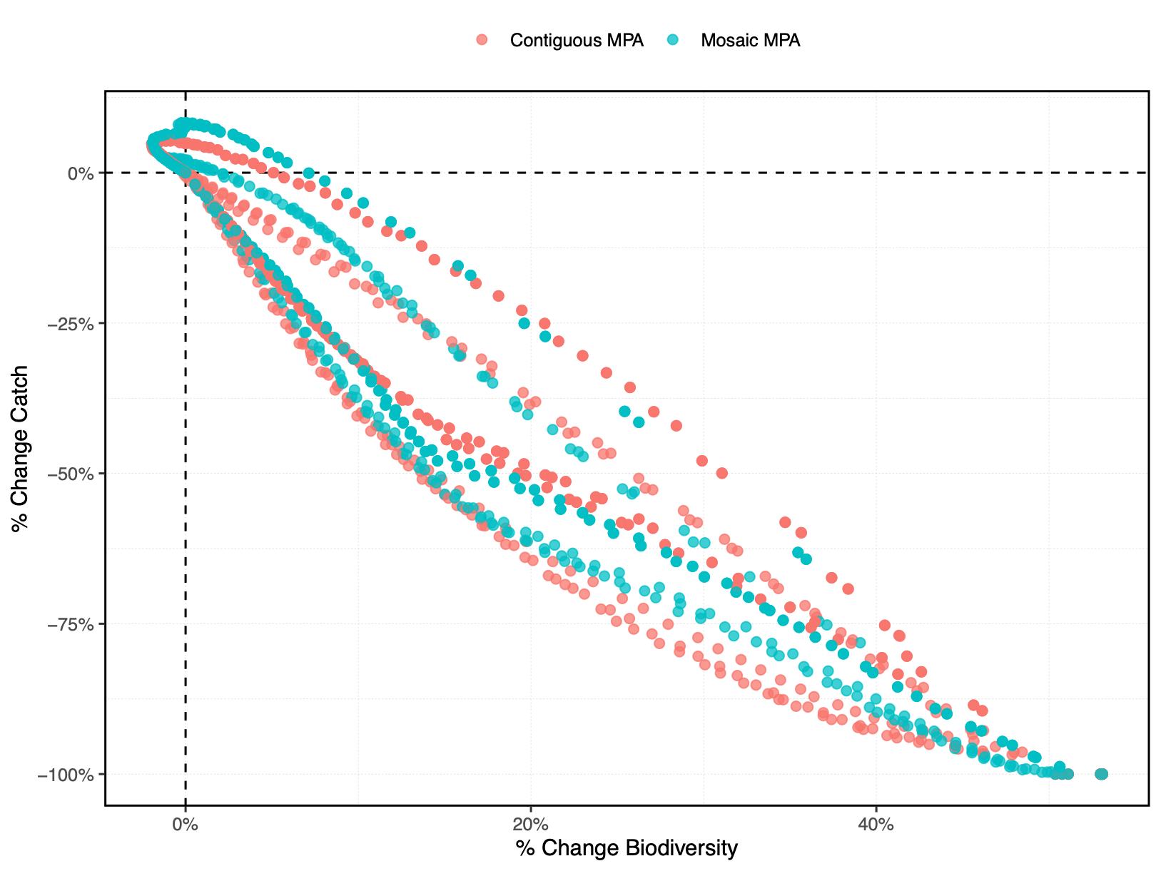
marlin In Action
Tradeoffs between Conservation and Fishing
Notes:
Iterating over uncertainty in MPA design strategy, adult and larval movement rates, and MPA size

Slide 11
Questions? Thanks!
github.com/DanOvando/marlin

Slide 12
Extras

Slide 13
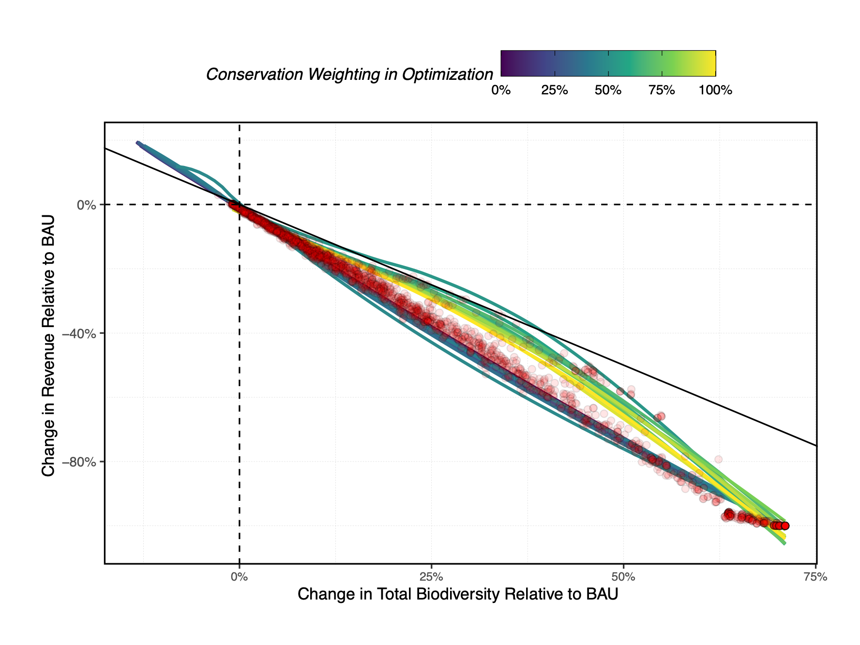
marlin In Action
Simulation Testing

Slide 14
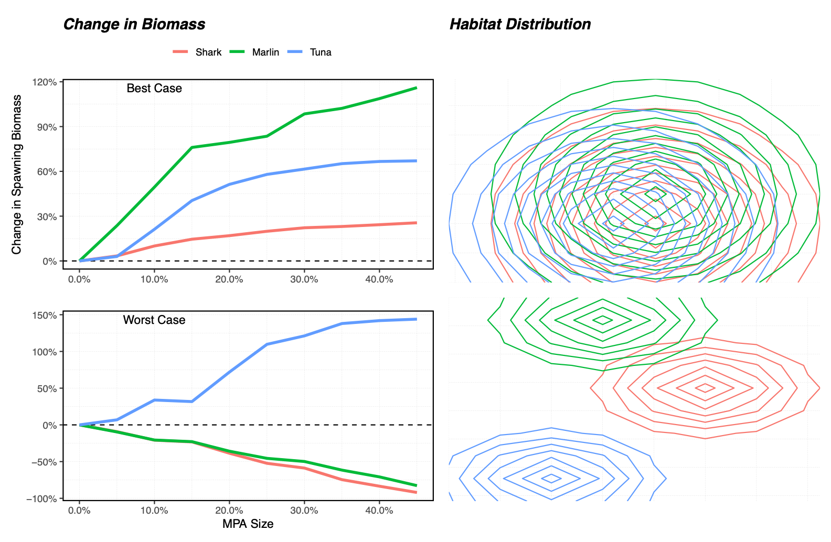
marlin In Action

Slide 15
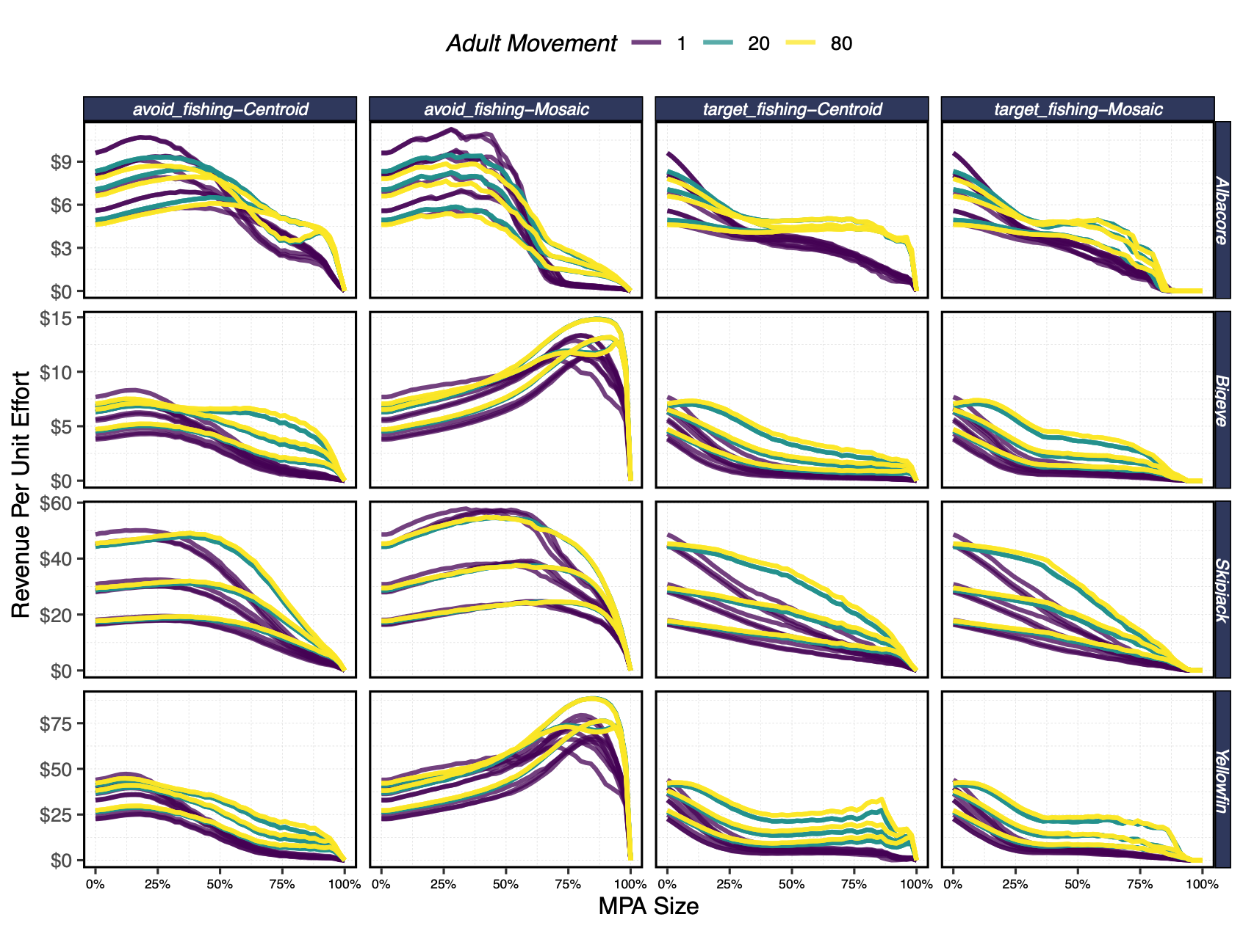
marlin In Action

Slide 16
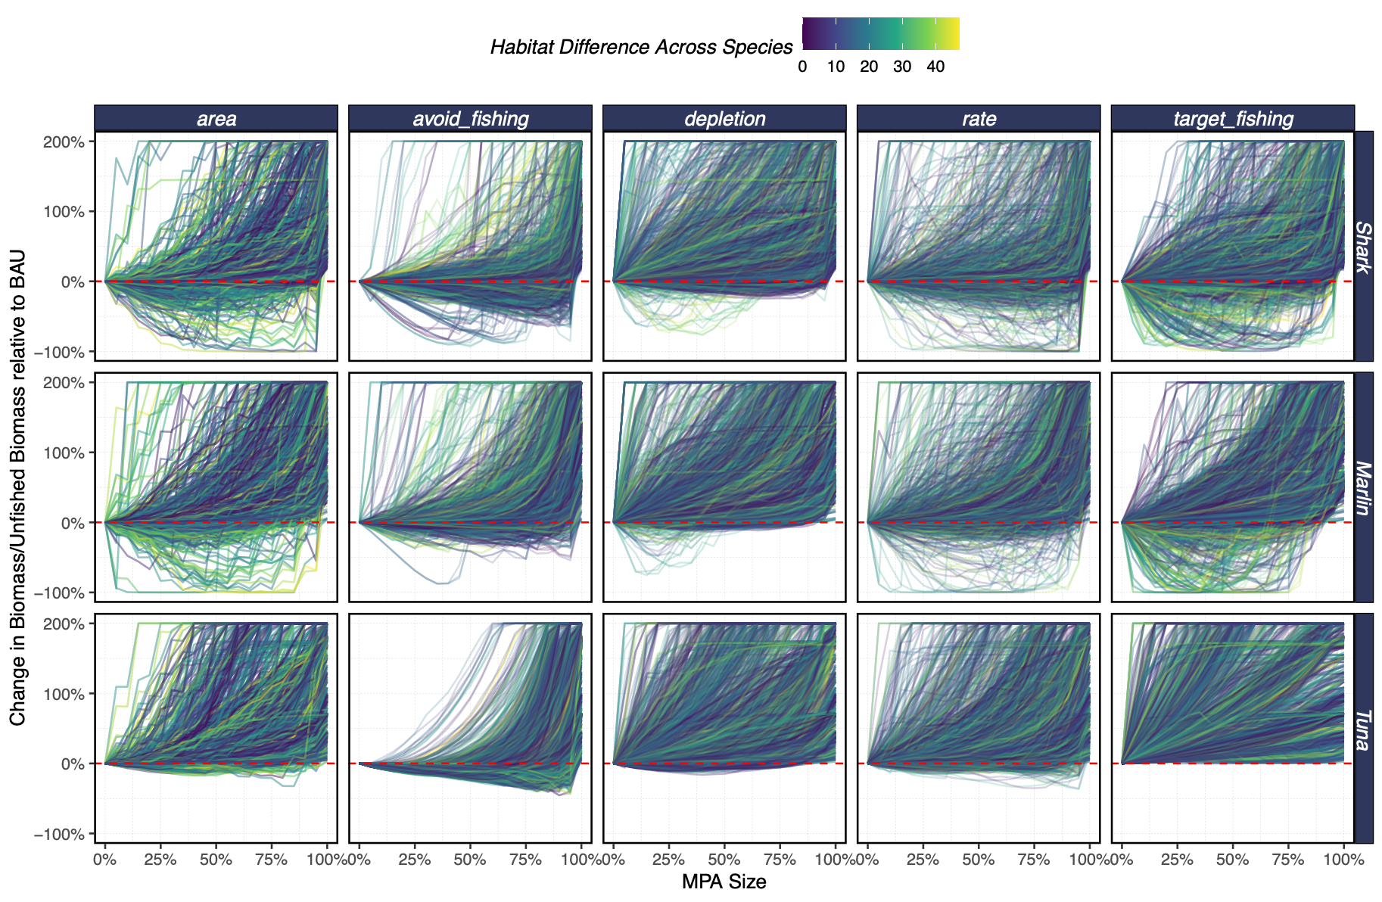
marlin In Action
Simulation Testing

